Slide 1
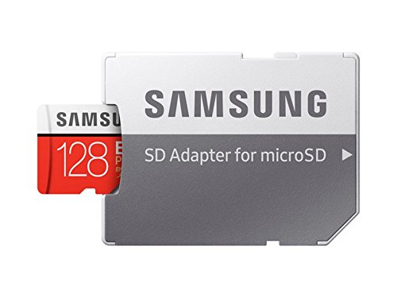
SENTIMENT ANALYSIS ON REVIEWS OF Samsung SD CARD PRODUCT LISTED ON AMAZON
SAMSUNG EVO Plus 128GB microSDXC UHS-I U3 100MB/s Full HD & 4K UHD Memory Card with Adapter (MB-MC128GA)

Slide 2

TEAM MEMBERS
Shashi Sharde
Shilpa Arnoliya
Shraddha Bhat
Shravani Srisailam
Varun Ramakrishna

Slide 3
Steps involved
1
Web Scrapping
2
Data Cleaning
Sentiment Analysis
3
4
Data Visualization
5
Topic Modelling
6
Model Building

Slide 4
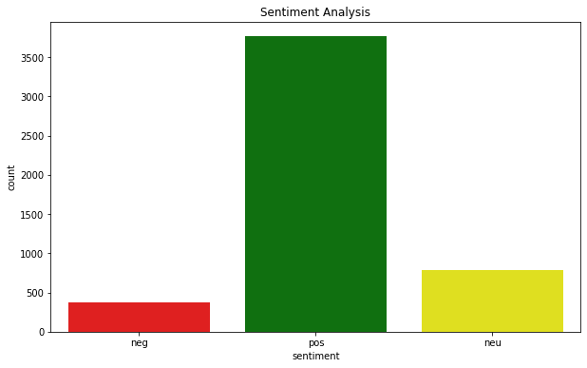
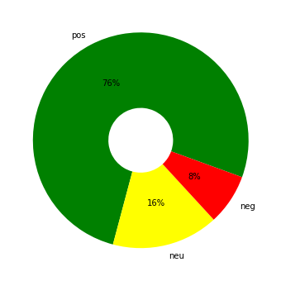
SENTIMENTAL ANALYSIS

Slide 5
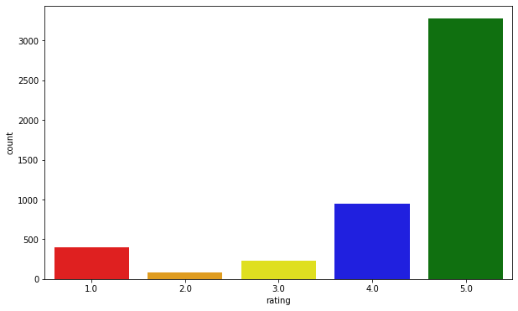
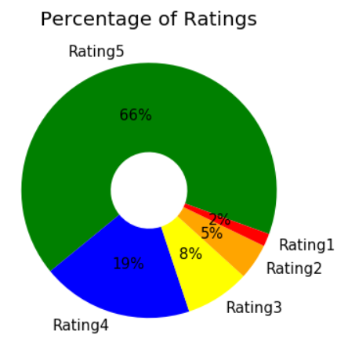
CUSTOMER RATINGS

Slide 6
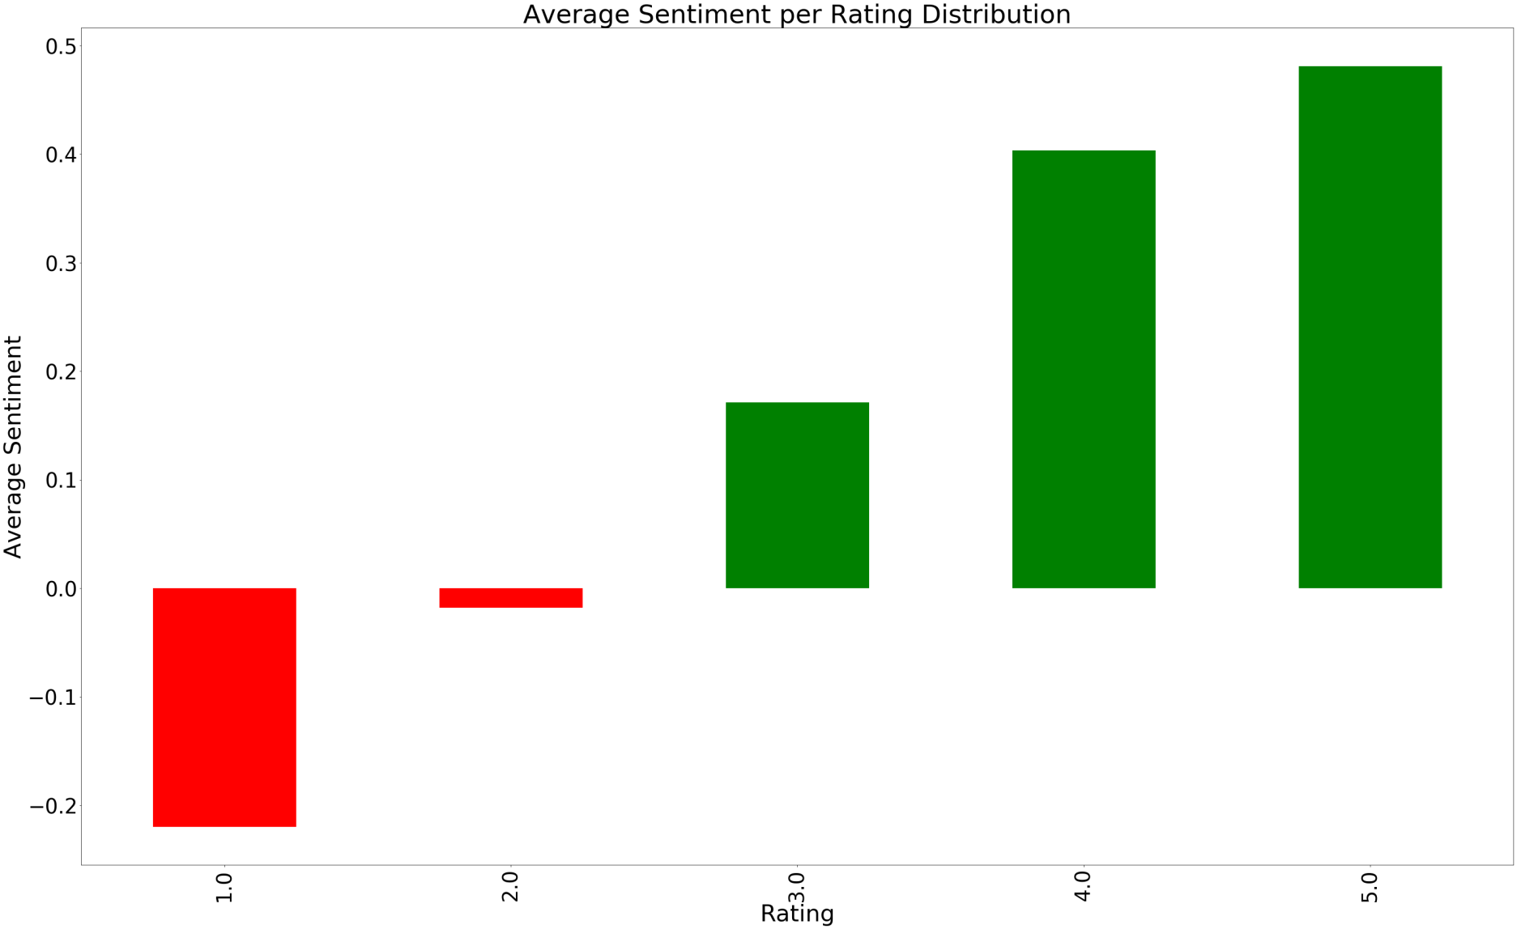
Average SENTIMENT vs. customer RATING DISTRIBUTION

Slide 7
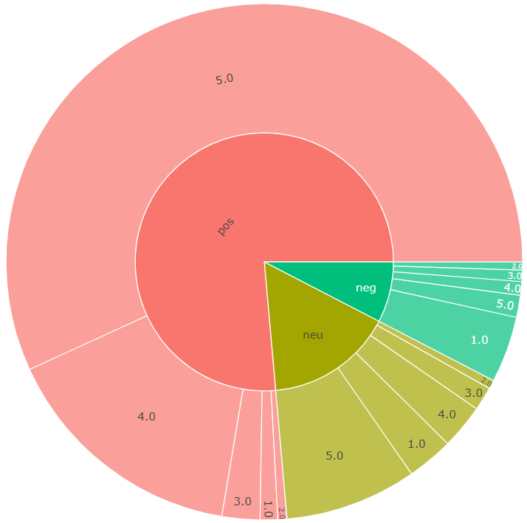

Slide 8
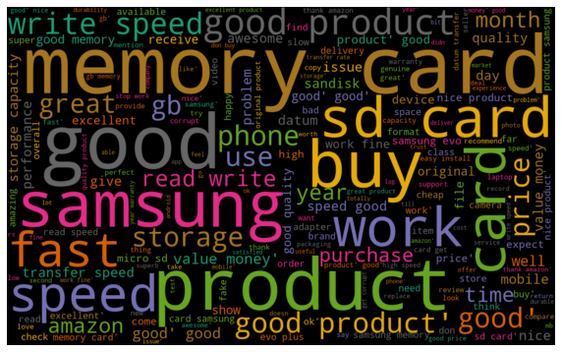
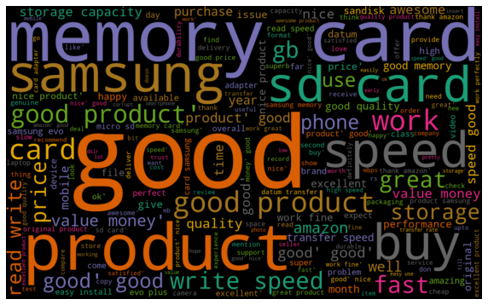
WORD CLOUD
OVER ALL reviews
Positive reviews

Slide 9
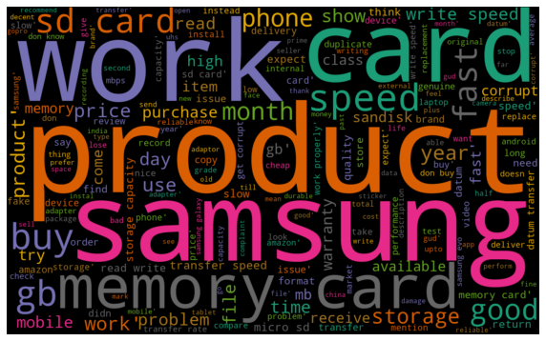
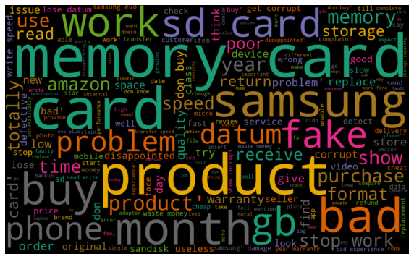
WORD CLOUD
NEUTRAL reviews
NEGAtive reviews

Slide 10
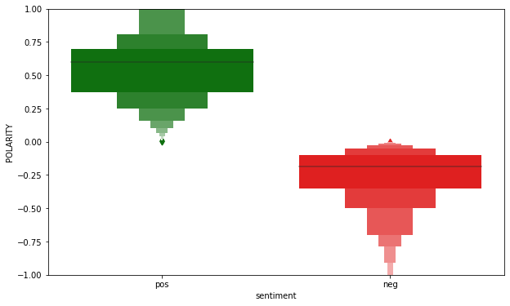
SENTIMENT vs. POLARITY

Slide 11
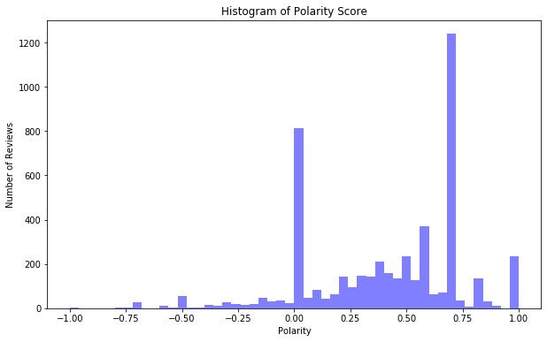
POLARITY SCORES

Slide 12
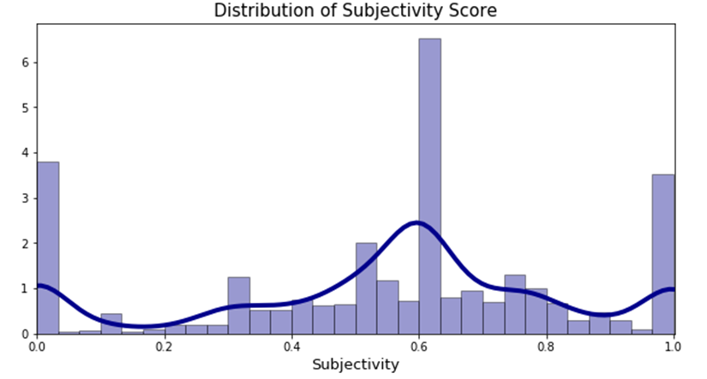
SUBJECTIVITY SCORES

Slide 13
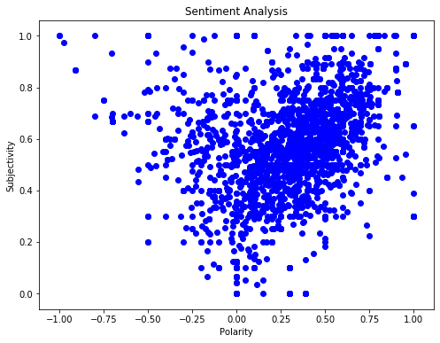
POLARITY vs. SUBJECTIVITY

Slide 14
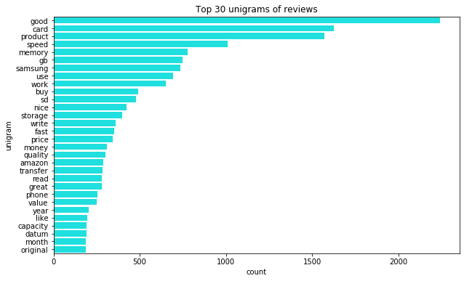
UNI-GRAM FREQUENCY CHART

Slide 15
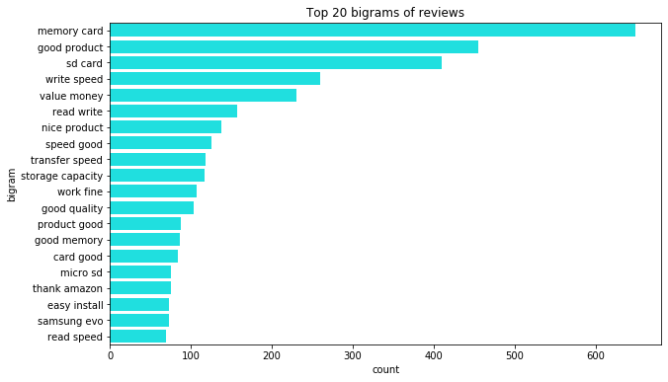
BI-GRAM FREQUENCY CHART

Slide 16
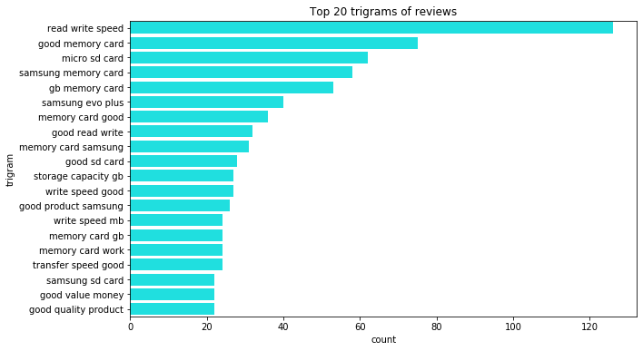
TRI-GRAM FREQUENCY CHART

Slide 17
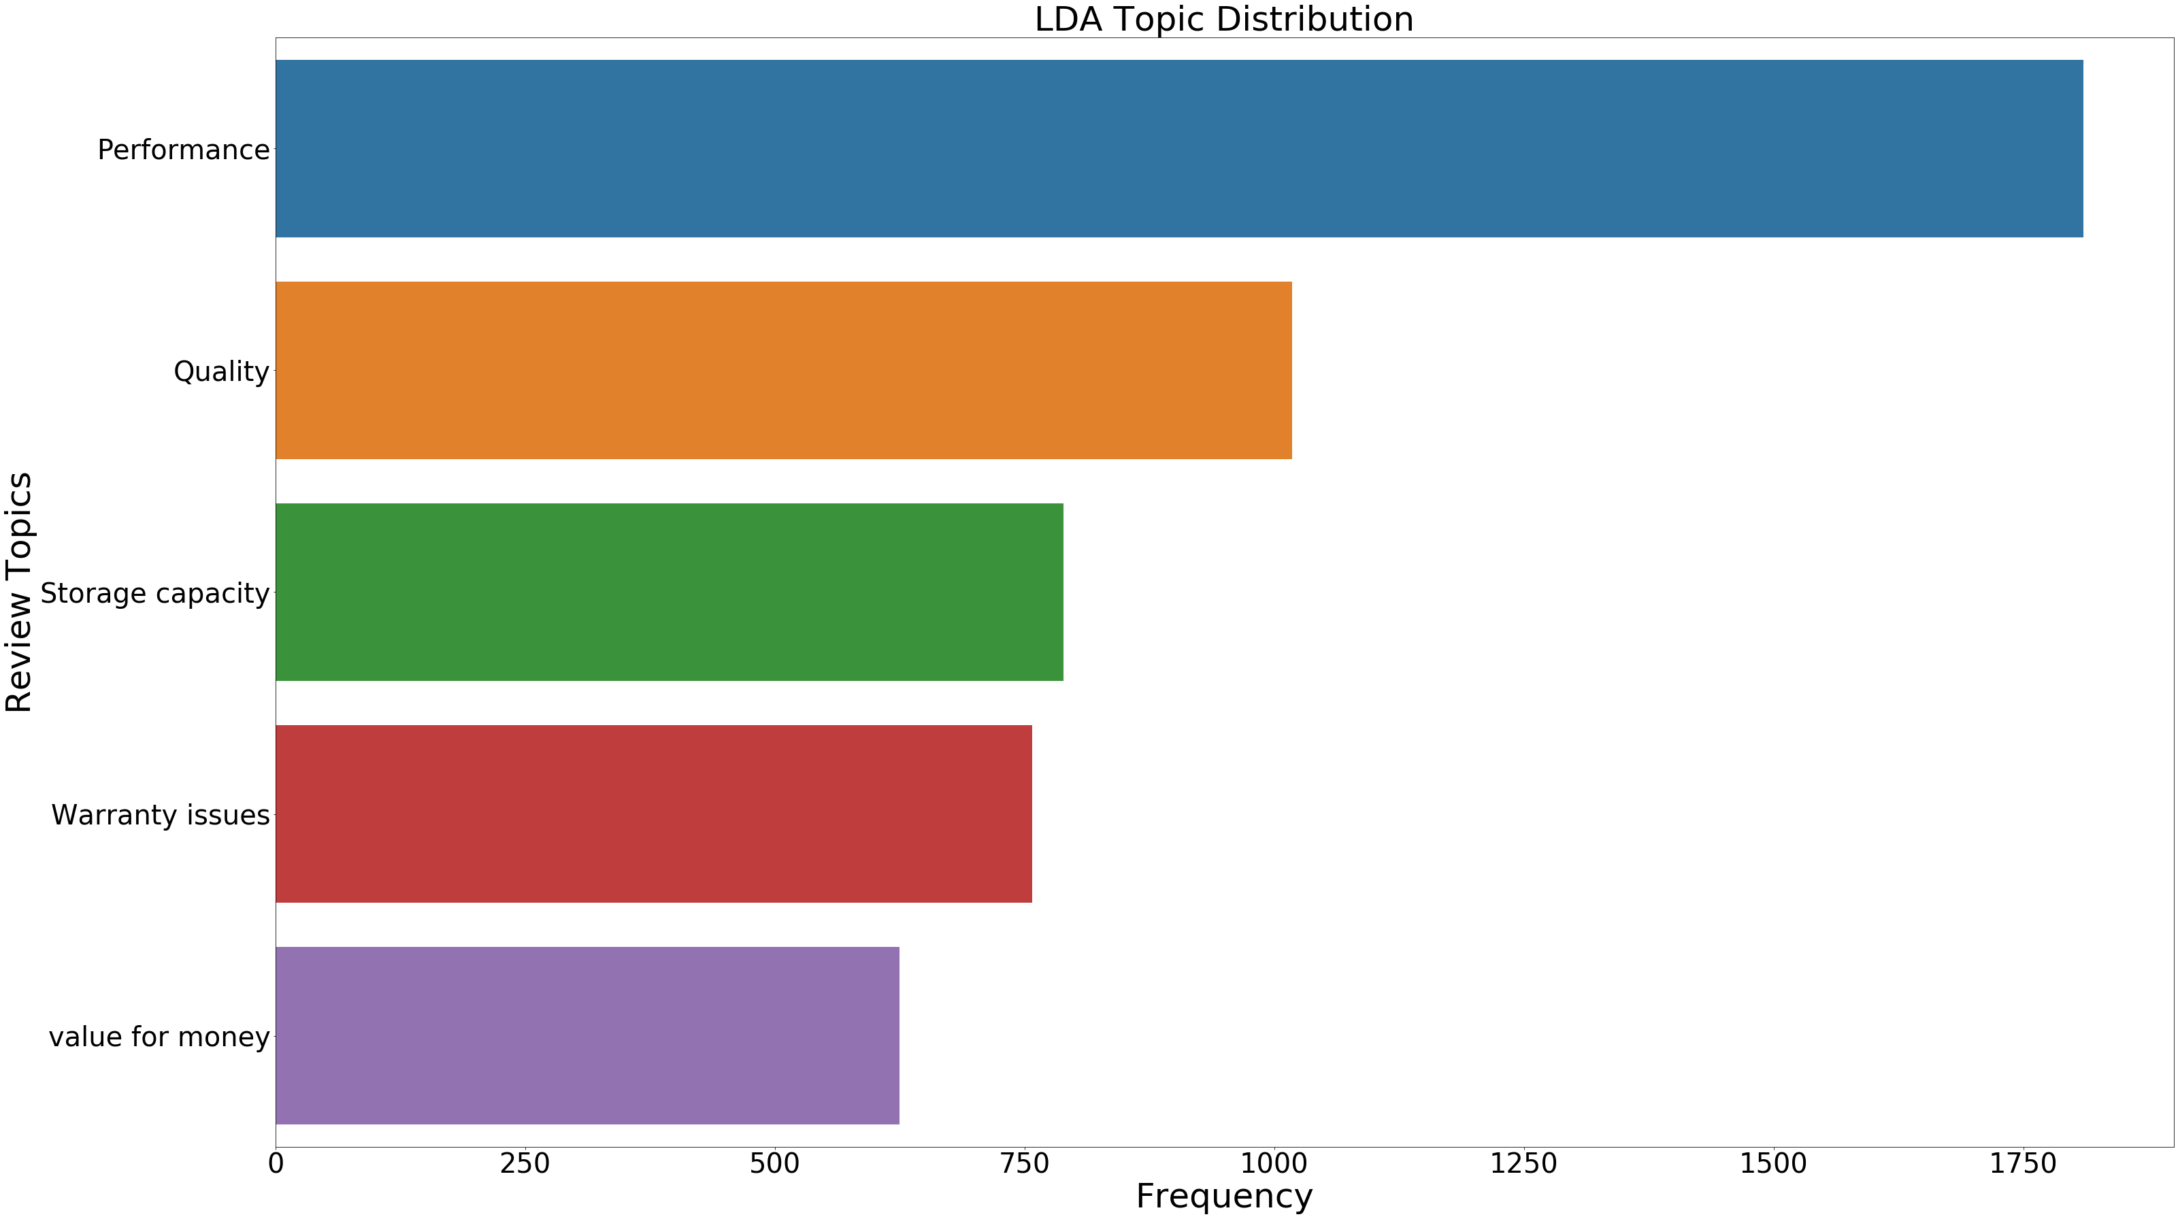
TOPIC MODELLING - LDA

Slide 18
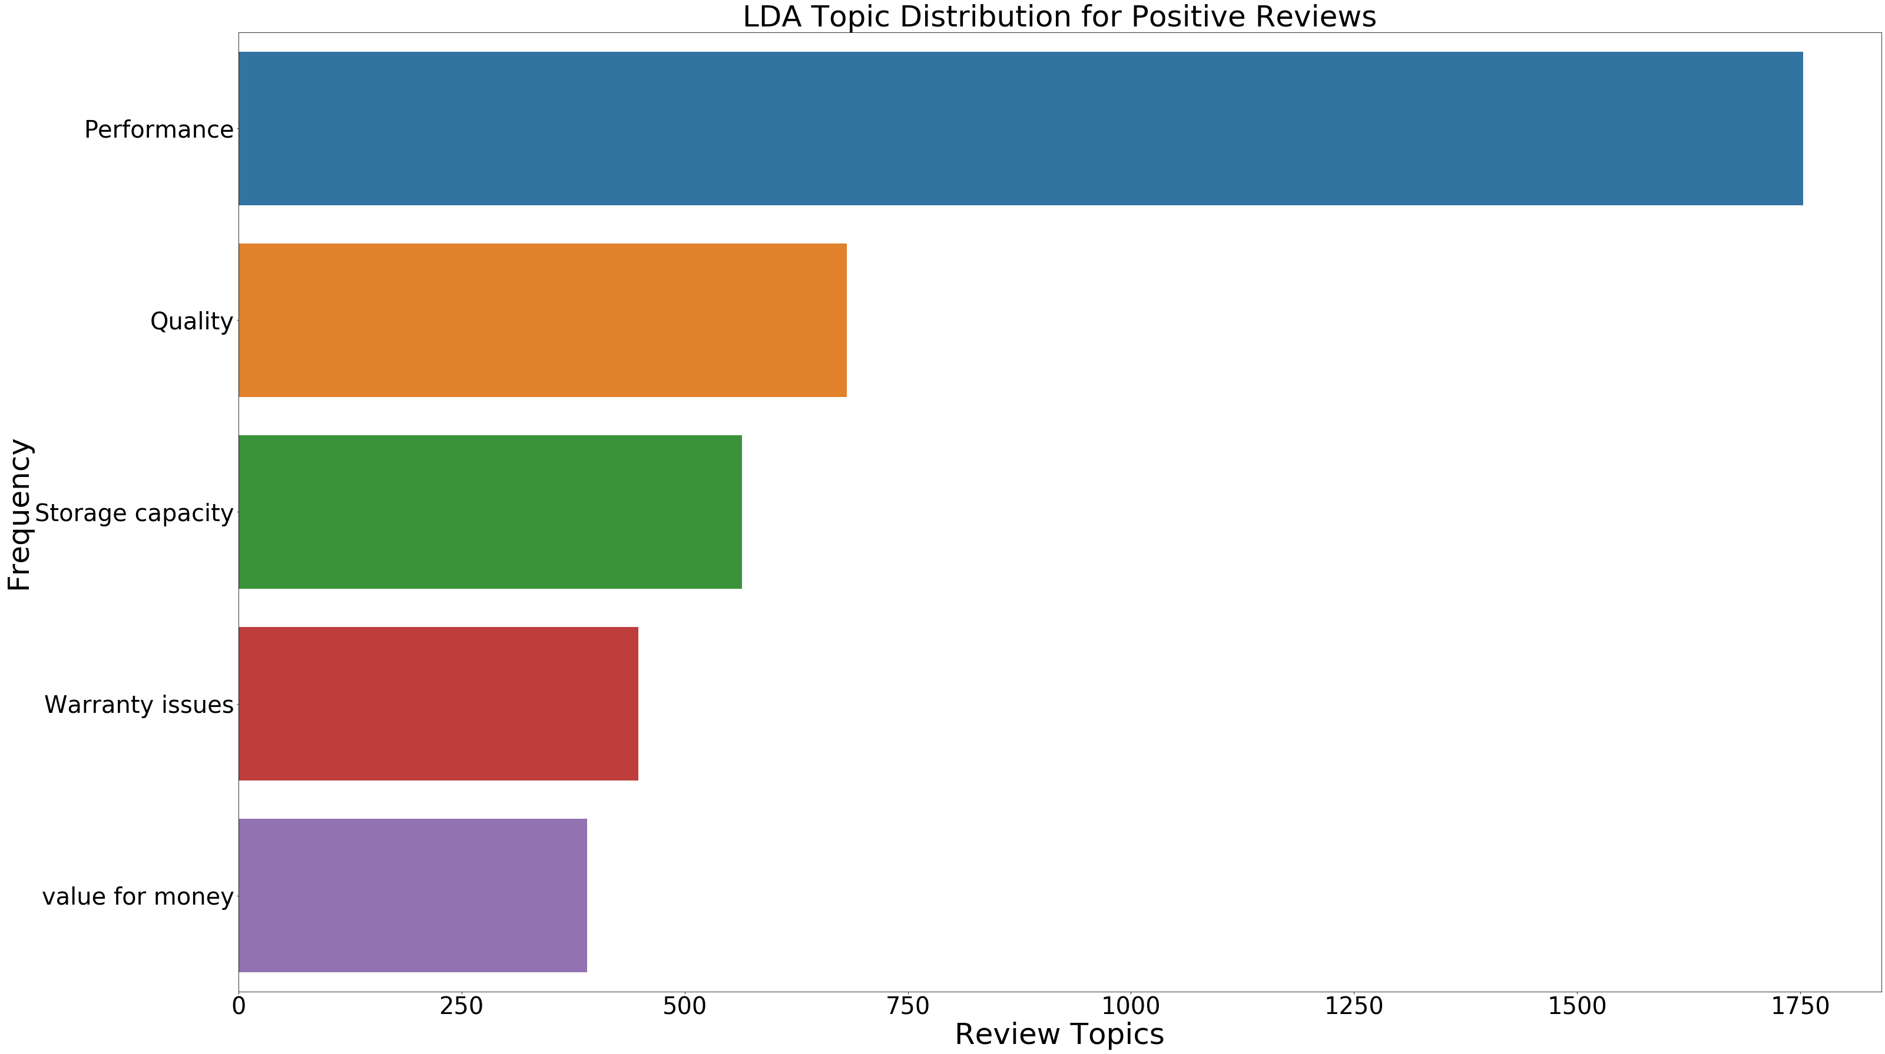
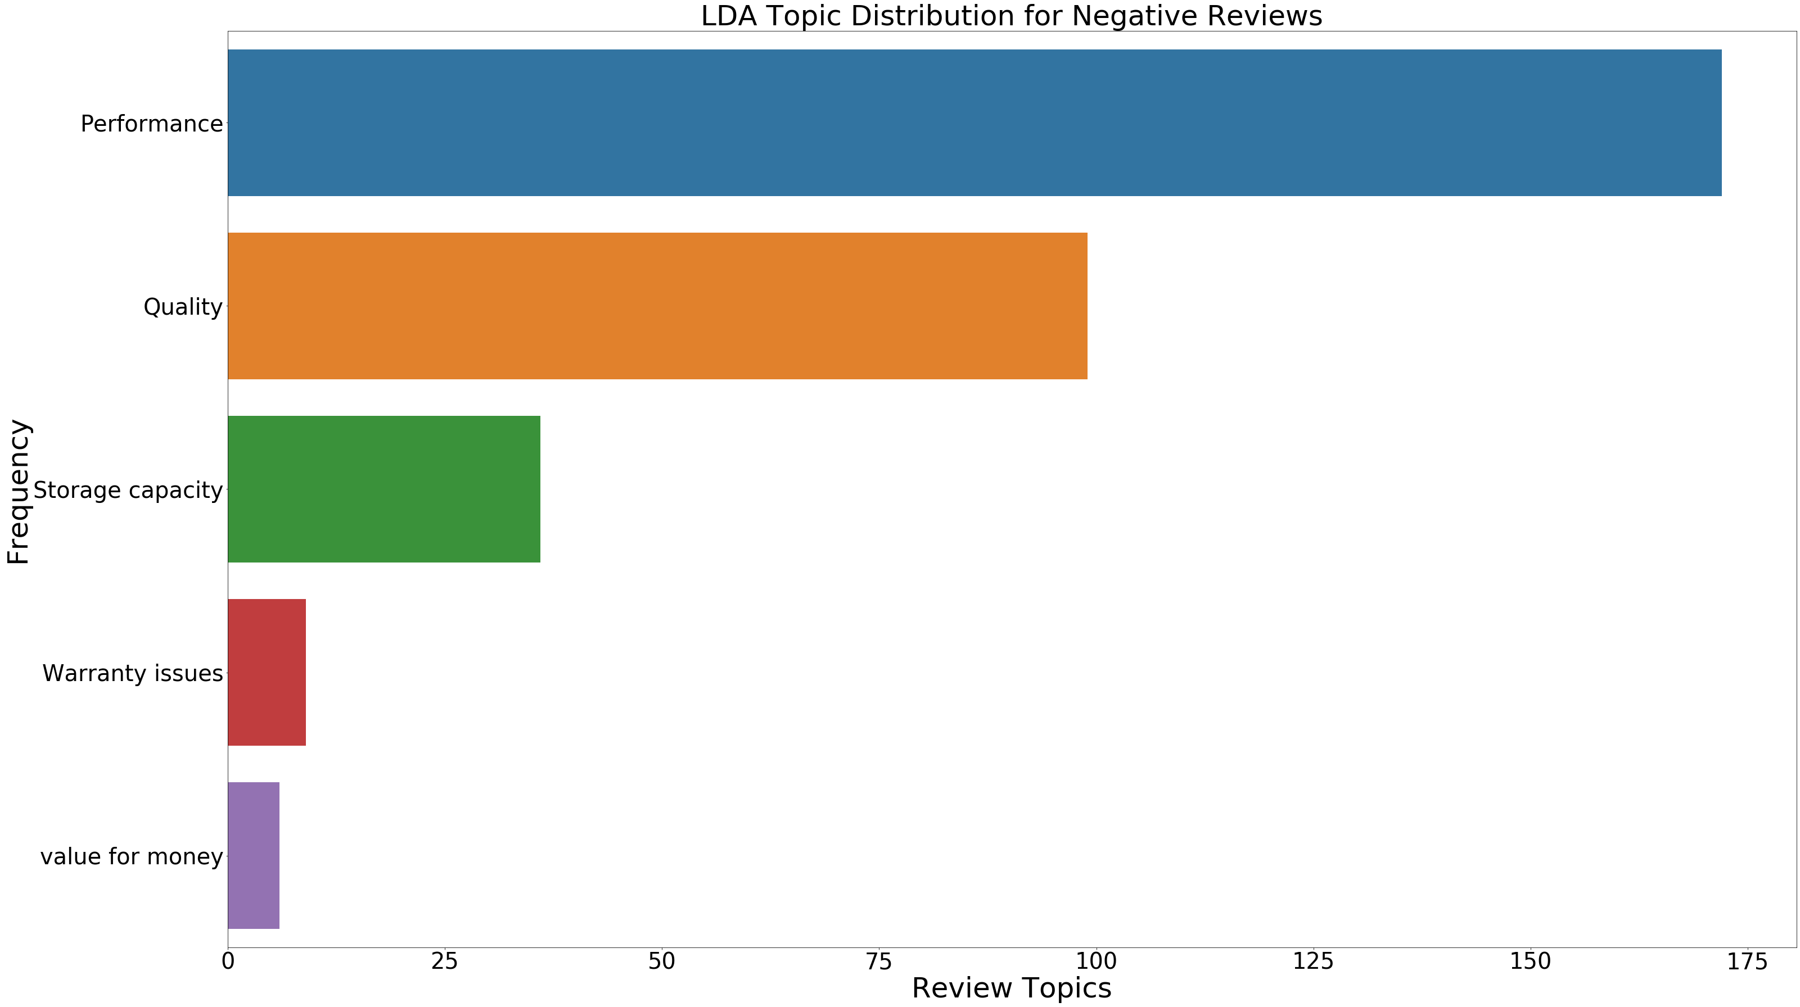
TOPIC DISTRIBUTION
POSITIVE reviews
NEGAtive reviews

Slide 19
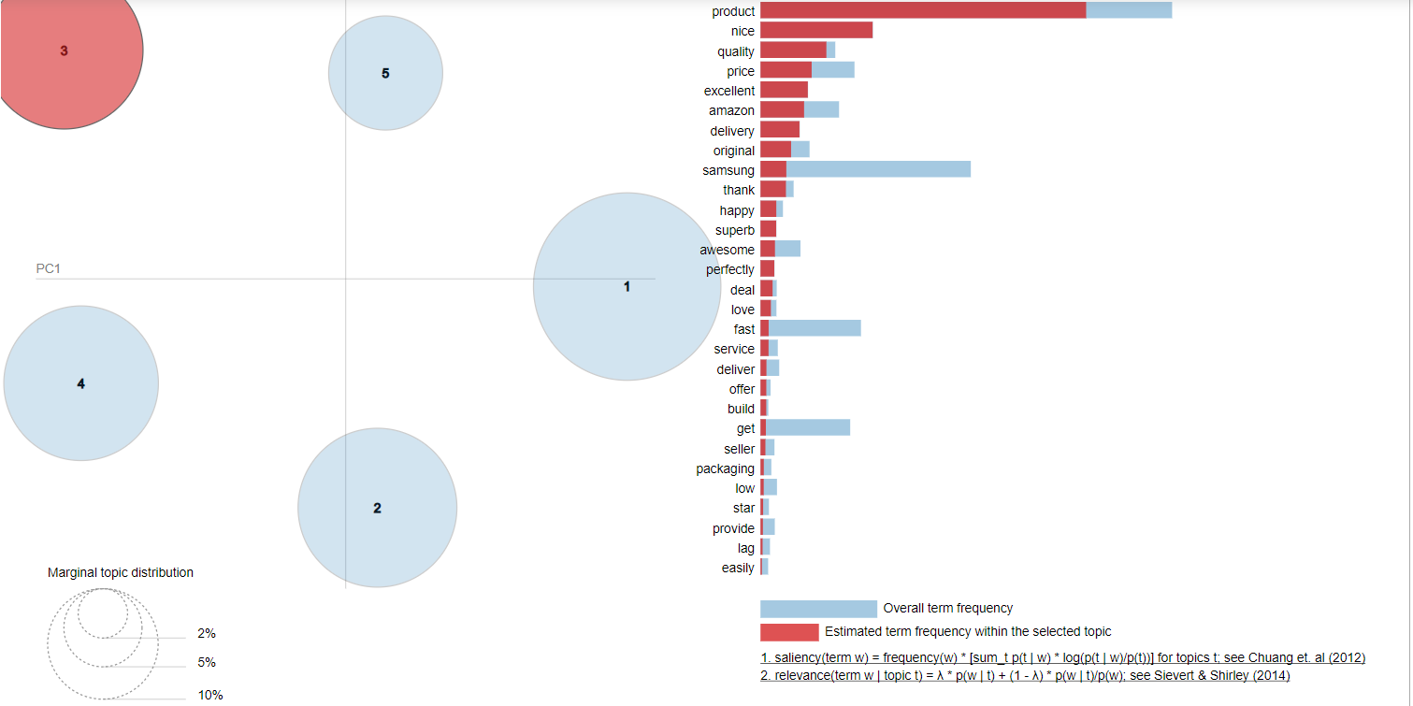
Intertopic Distance Map
http://localhost:8888/notebooks/Downloads/EDAonSamsungReviews.ipynb

Slide 20
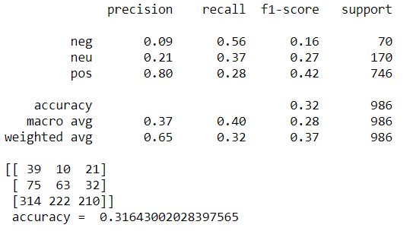
NAÏVE BAYES MODEL METRICS

Slide 21
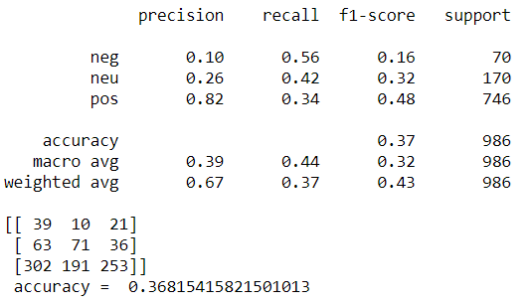
NAÏVE BAYES MODEL METRICS AftEr applYing smote

Slide 22
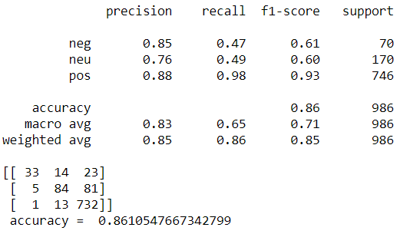
RANDOM FOREST MODEL METRICS

Slide 23
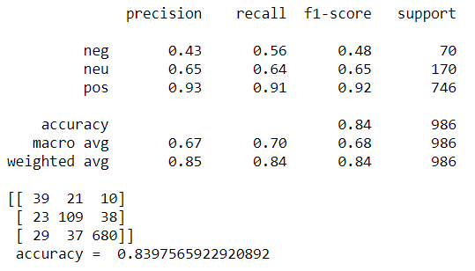
RANDOM FOREST MODEL METRICS AftEr applYing smote

Slide 24
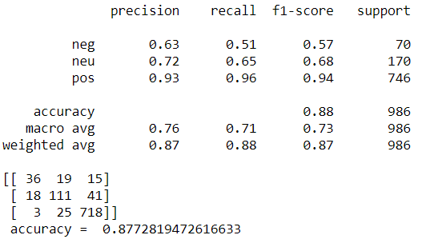
SVM MODEL METRICS

Slide 25
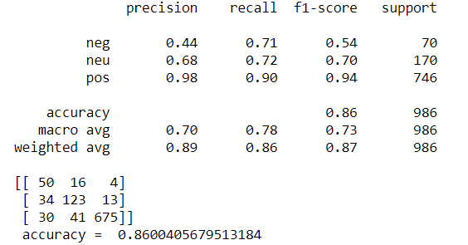
SVM MODEL METRICS AftEr applYing smote

Slide 26
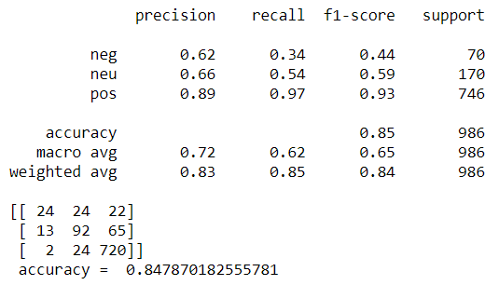
LOGISTIC REGRESSION MODEL METRICS

Slide 27
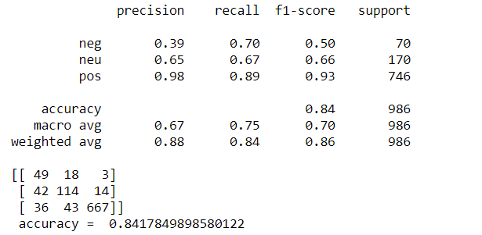
LOGISTIC REGRESSION MODEL METRICS AftEr applYing smote

Slide 28
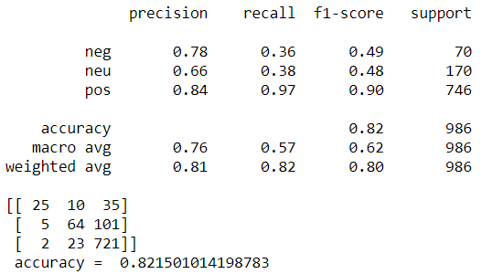
XGB CLASSIFIER MODEL METRICS

Slide 29
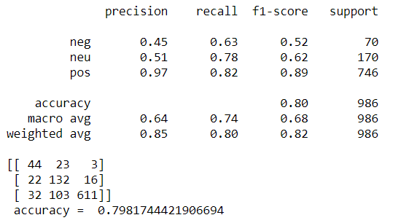
Xgb MODEL METRICS AftEr applYing smote

Slide 30
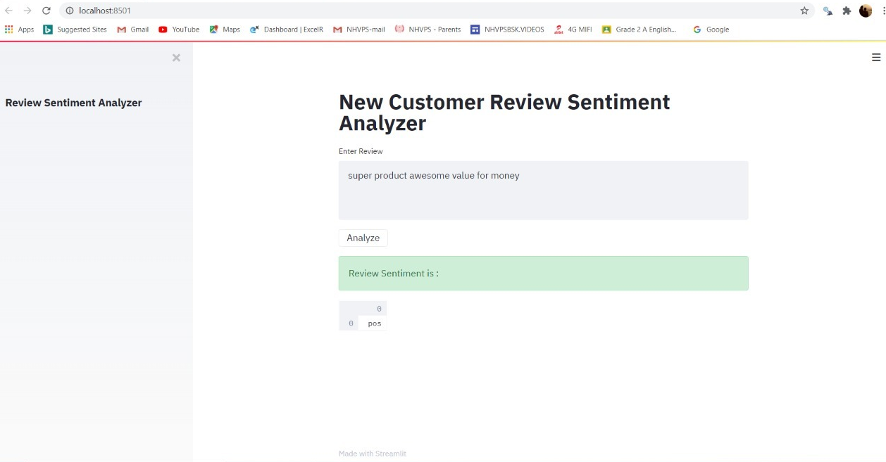
Model Deployment - sTREAMLIT
EXAMPLE FOR POSITIVE REVIEW

Slide 31
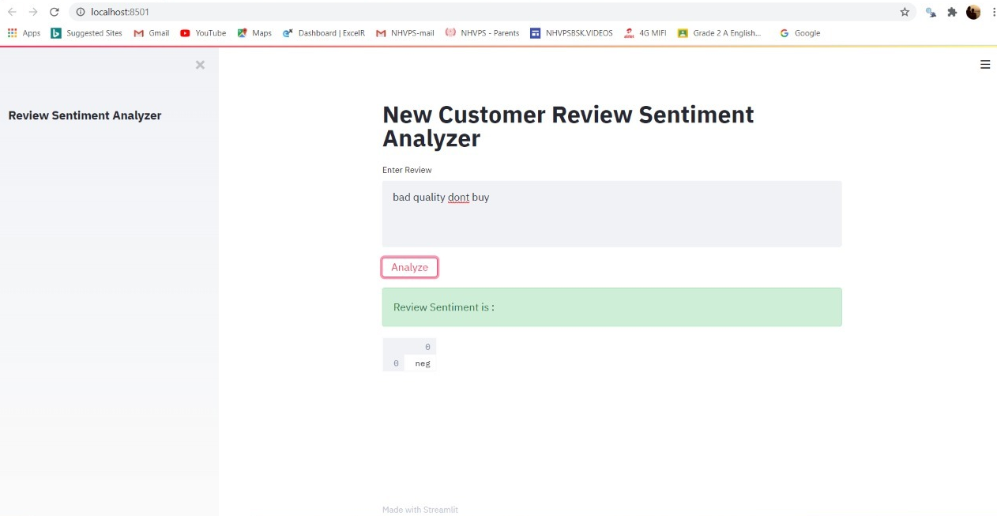
Model Deployment
EXAMPLE FOR nEGATIVE REVIEW

Slide 32
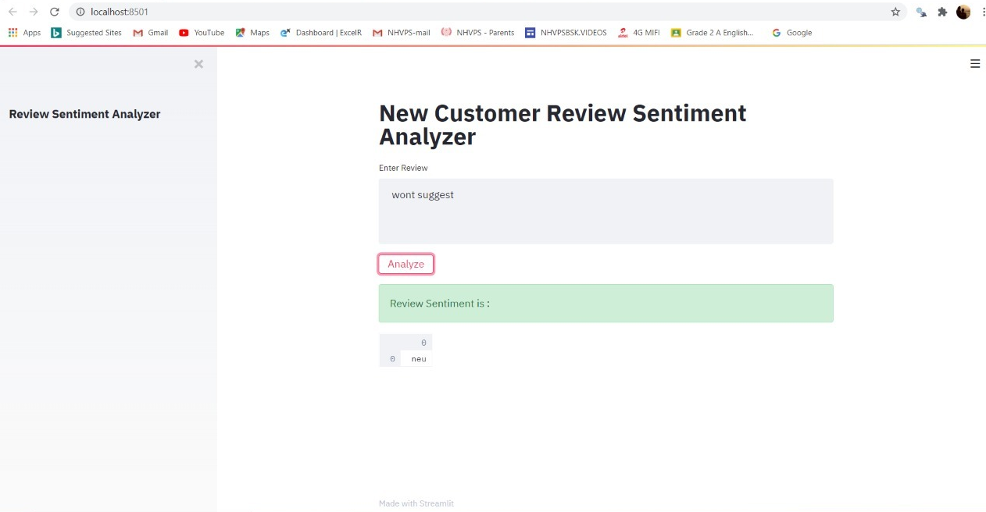
Model Deployment
EXAMPLE FOR nEUTRAL REVIEW

Slide 33
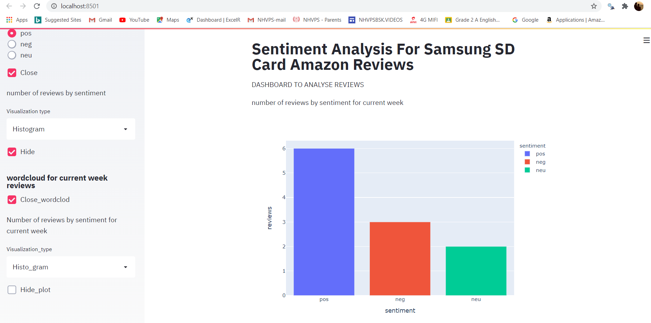
Model Deployment – CURRENT WEEK
Sentiment Analysis on Current week reviews

Slide 34
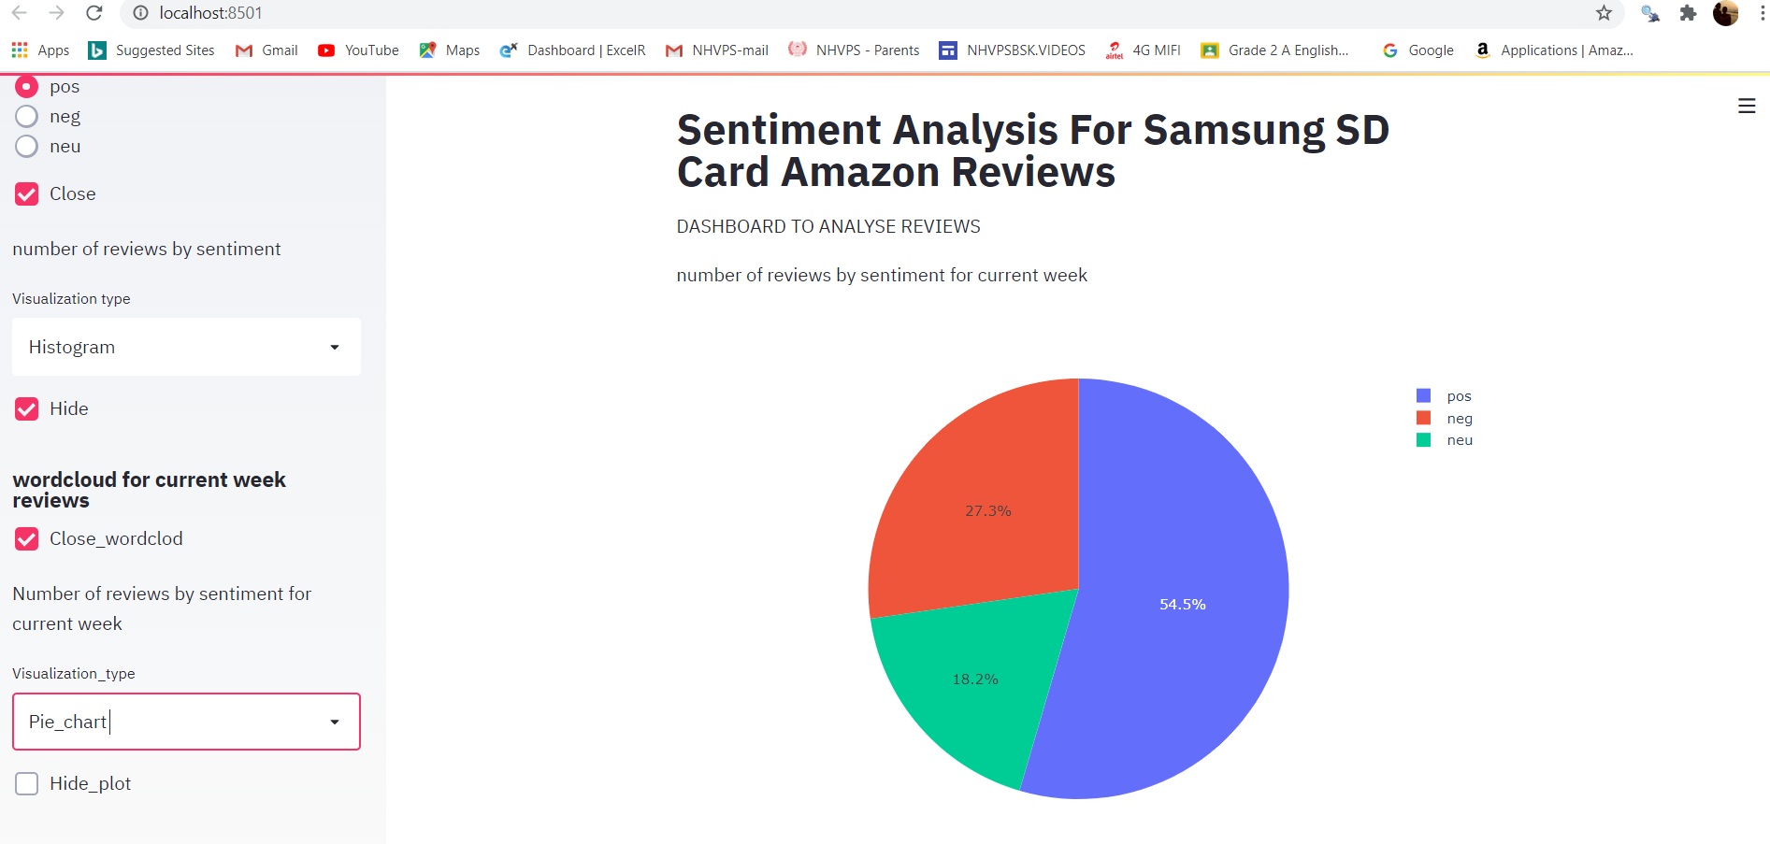
Model Deployment
Sentiment Analysis on Current week reviews

Slide 35
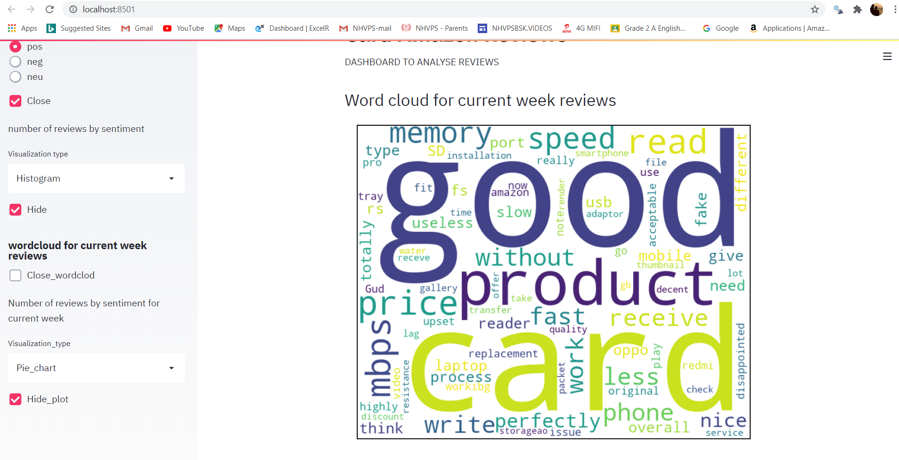
Model Deployment – CURRENT WEEK REVIEW ANALYSIS
Sentiment Analysis on Current week reviews

Slide 36
summary
5000 customer reviews are scrapped by using scrapy
The product has more than 76% of positive reviews from its customers
The sentimental analysis on the customer reviews is matching with the customer ratings
The polarity chart clearly shows negative skewness as it has more positive reviews
Scatter plot for polarity scores and subjectivity scores shows a positive correlation
Topic modelling by LDA is considered for the further analysis as it is giving more specific clustering of the words compared to NMF for this case
From the topic distribution plot, it is evident that most of the customer reviews are about the performance and the quality of the product
And we also see a topic related to customer disappointment about the product warranty, durability of the product and genuineness of the product description in the website
From both the topic modelling and from the sentiment analysis for the customer reviews it is concluded that the customer are happy and satisfied with the product
Random forest, SVM, Logistic regression, XGBOOST and Naive bayes classification models are built for the review data
As the data shown more imbalance in its classes SMOTE has been applied for all the models
SVM model with SMOTE application shows the better metrics for all the three classes
Automation of reviews extraction is done by scheduling it in windows task scheduler on weekly basis
Model has been deployed using Streamlit to get the sentiment of new review
Model deployment is also done for getting sentiment analysis for the current week reviews

Slide 37
THANKS
Any Questions?

